Slide 1
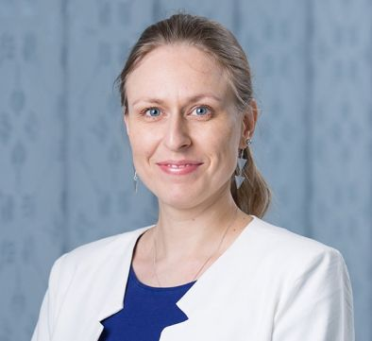
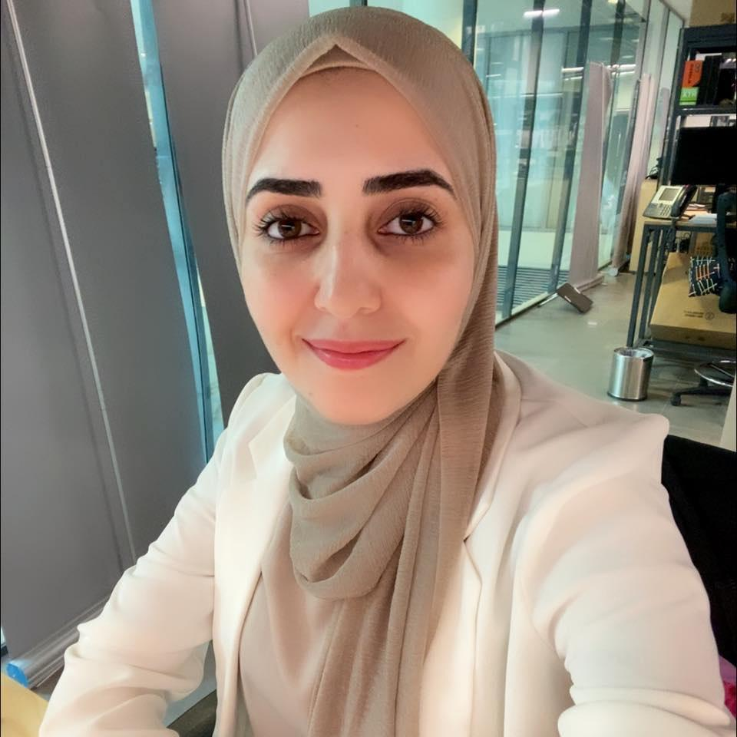
Applied Research Competition MENA Region
Organizers
Christina Pöpper
Assistant Professor of Computer Science
Ala Darabseh
Research Engineer
Dunia J. Mahboobeh
Research Assistant

Slide 2
Applied Research Competition MENA Region
Finalists
Zihang Xiang (KAUST)
Preserving Node-level Privacy in Graph Neural Networks
Muhusina Ismail (UAEU)
A Comprehensive Evaluation of Machine Learning Algorithms for Web Application Attack Detection with Knowledge Graph Integration
Shamma Alalawi (UAEU)
A Comparative Study on Source Code Attribution Using AI: Datasets, Features, and Techniques
Meera Alalawi (UAEU)
Evaluating and Boosting Cybersecurity Awareness With an AI-Integrated Mobile App
Robert Merget(TII)
With Great Power Come Great Side Channels: Statistical Timing Side-Channel Analyses with Bounded Type-1 Errors
Marouene Boubakri(KAUST)
Architectural Security and Trust Foundation for RISC-V
Waleed Arshad (Lahore University of Management Sciences)
“I chose to fight, be brave, and to deal with it": Threat Experiences and Security Practices of Pakistani Content Creators
Roy Weiss (Ben-Gurion University)
What Was Your Prompt? A Remote Keylogging Attack on AI
Aviv Yaish (The Hebrew University)
Speculative Denial-of-Service Attacks In Ethereum

Slide 3
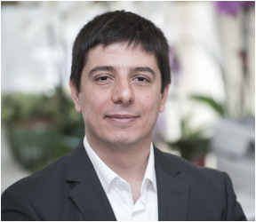
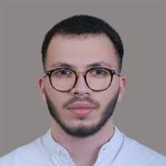
Applied Research Competition MENA Region
Judges
Hazim Kemal Ekenel
ITU
Lilas Alrahis
Khalifa University
Ahmed Almeligy,
Lockheed Martin
Christina Pöpper
NYUAD

Slide 4
Applied Research Competition MENA Region
2rd PLACE
goes to
Robert Merget
for the paper entitled
“With Great Power Come Great Side Channels: Statistical Timing Side-Channel Analyses with Bounded Type-1 Errors
”

Slide 5
Applied Research Competition MENA Region
1rd PLACE
goes to
Marouene Boubakri
for the paper entitled
“Architectural Security and Trust Foundation for RISC-V”

